Slide 1
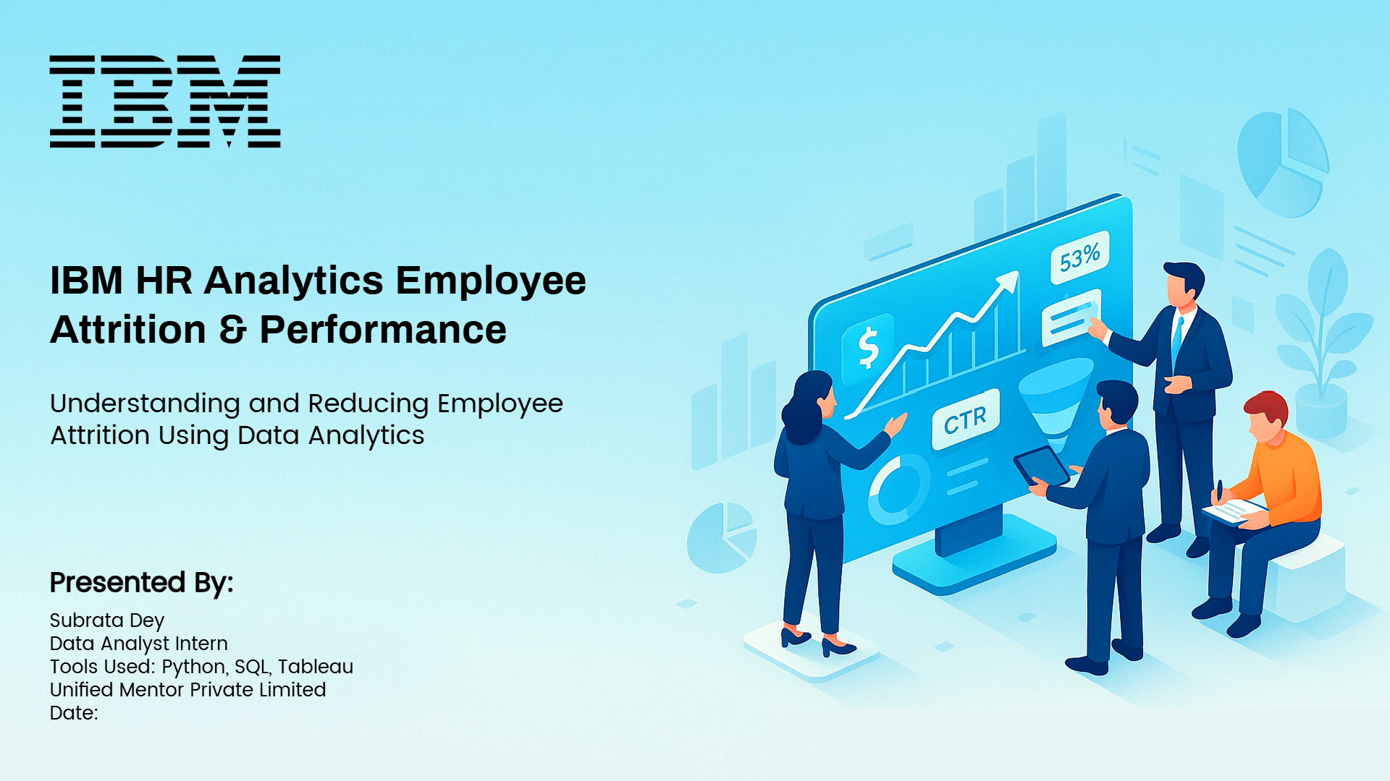
© Subrata Dey | Data Analyst | 2026

Slide 2
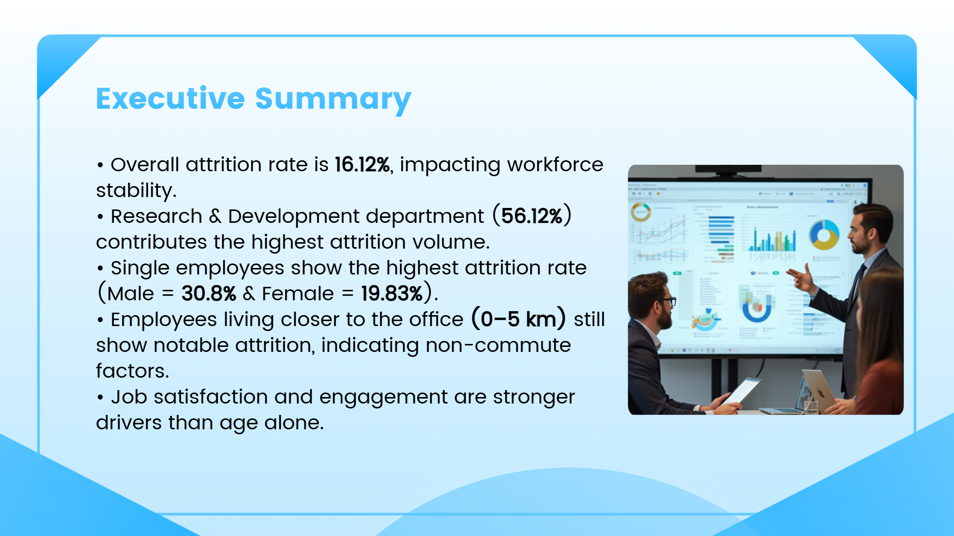
© Subrata Dey | Data Analyst | 2026

Slide 3
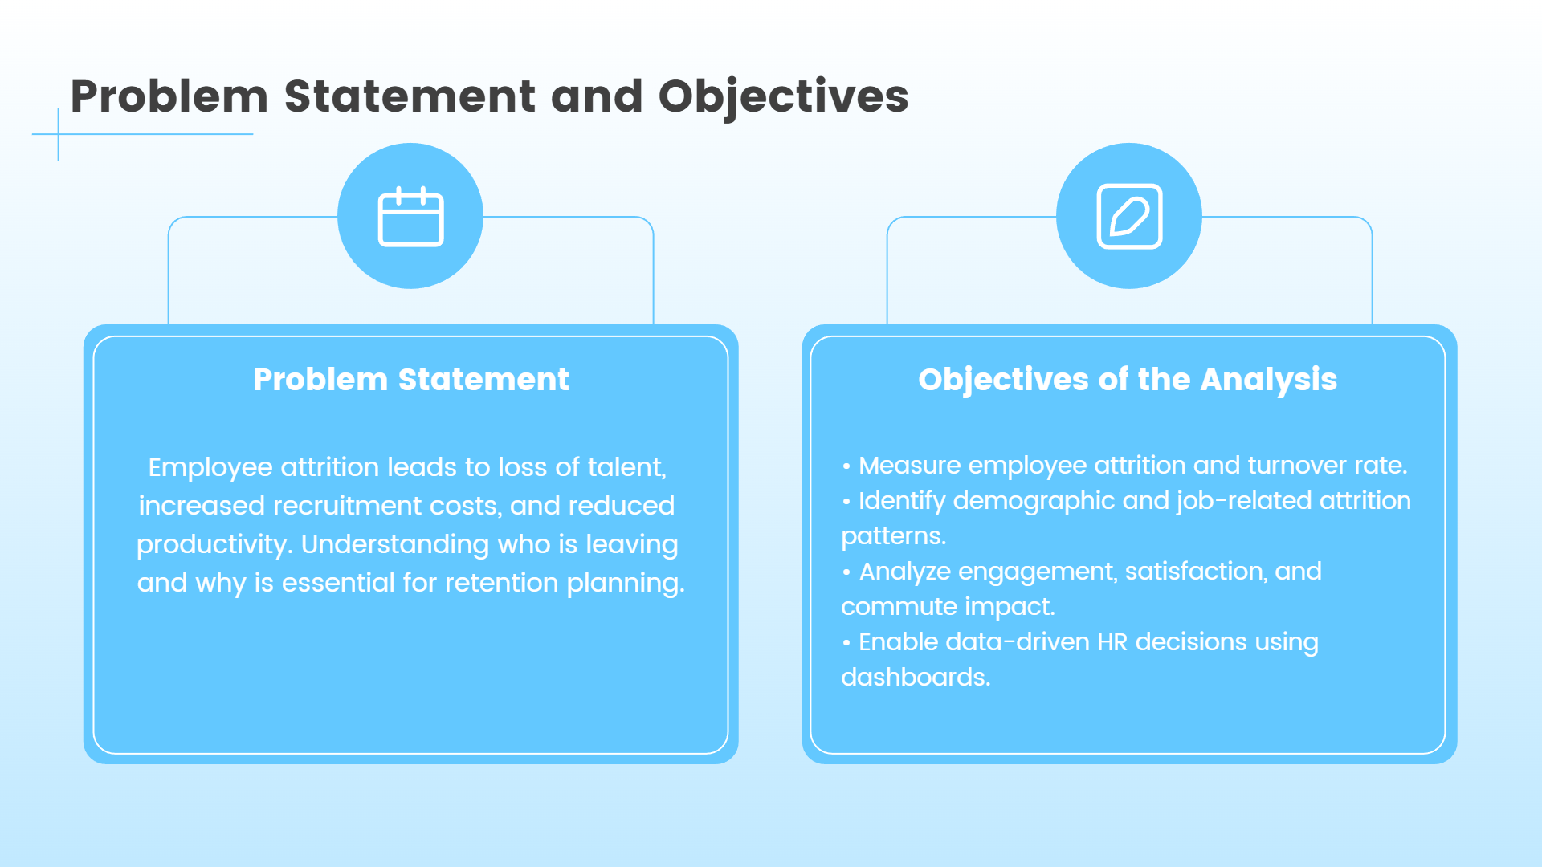
© Subrata Dey | Data Analyst | 2026

Slide 4
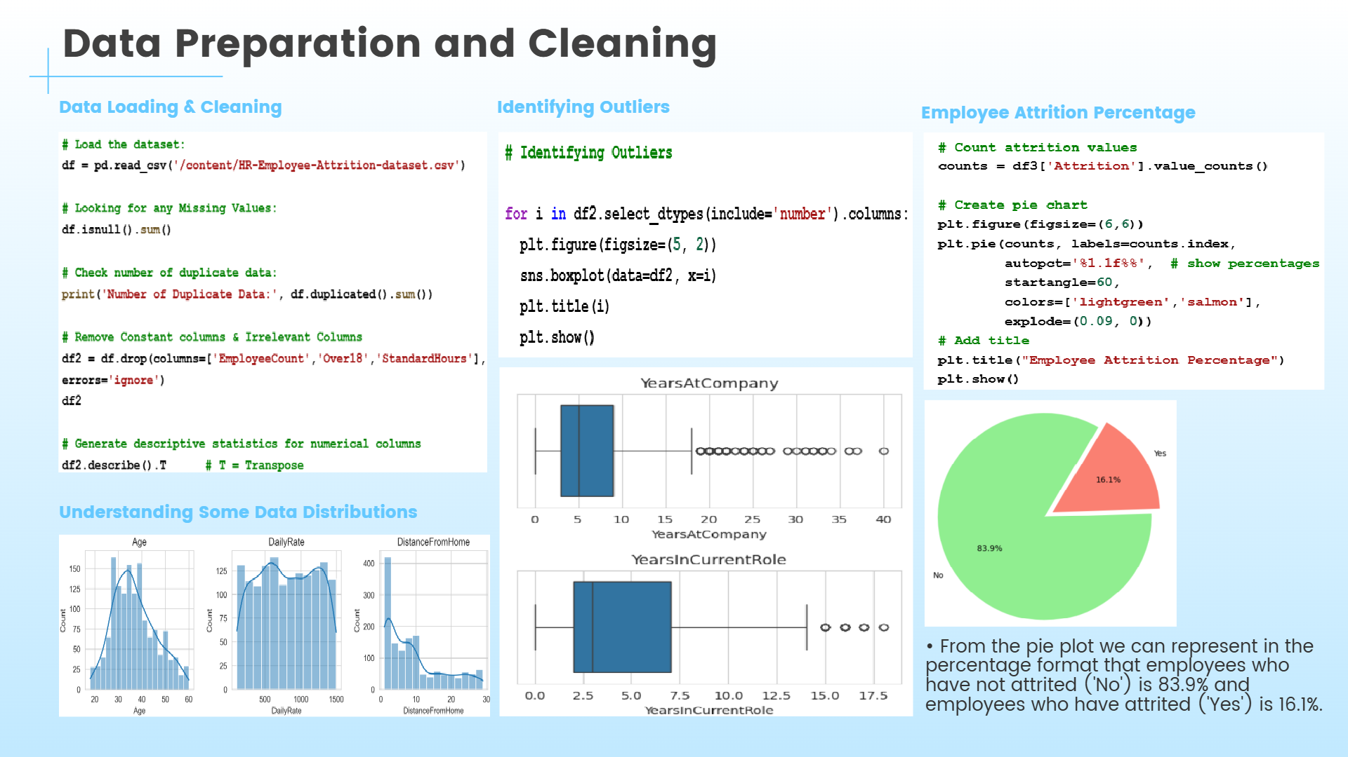
© Subrata Dey | Data Analyst | 2026

Slide 5
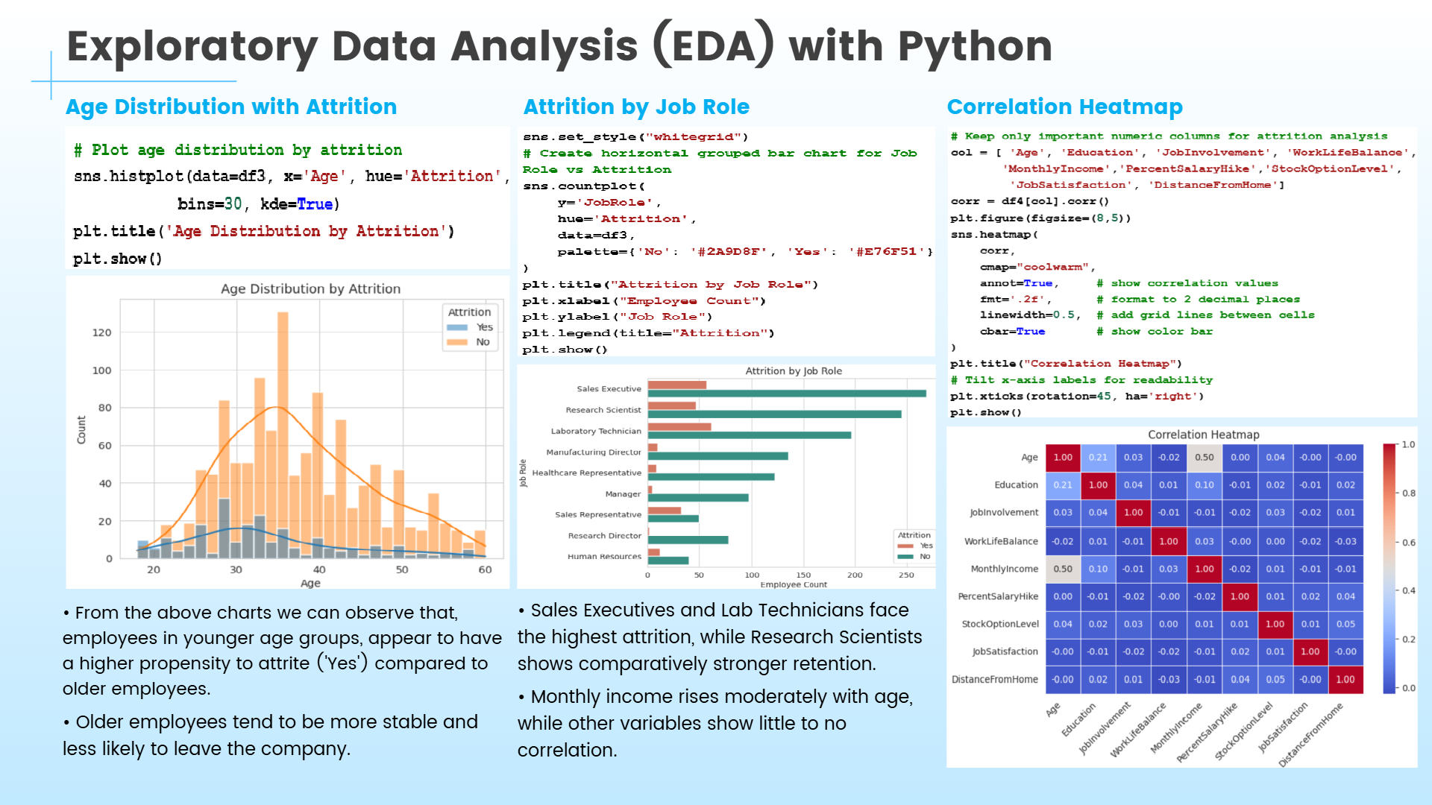
© Subrata Dey | Data Analyst | 2026

Slide 6
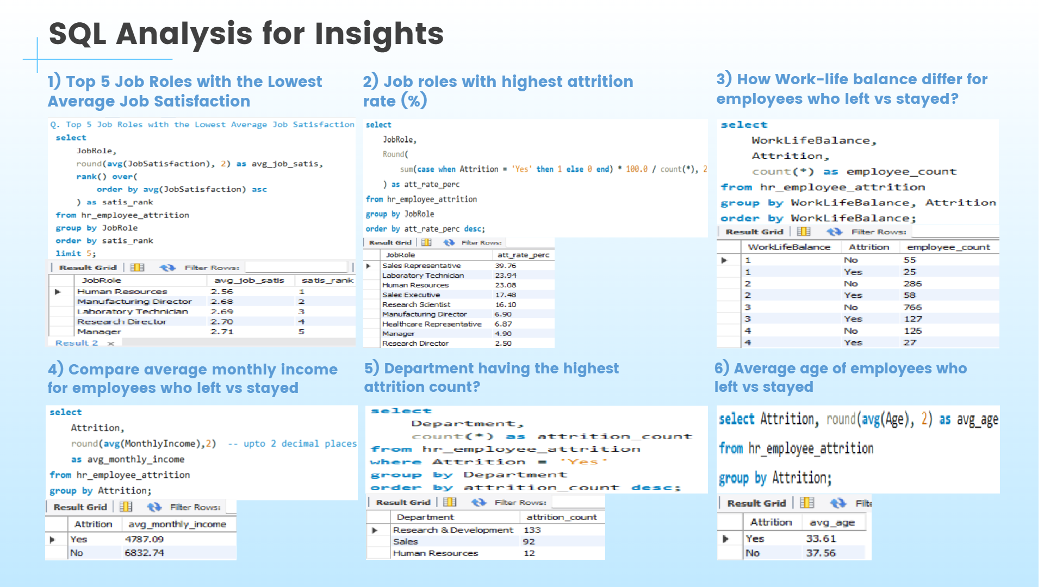
© Subrata Dey | Data Analyst | 2026

Slide 7

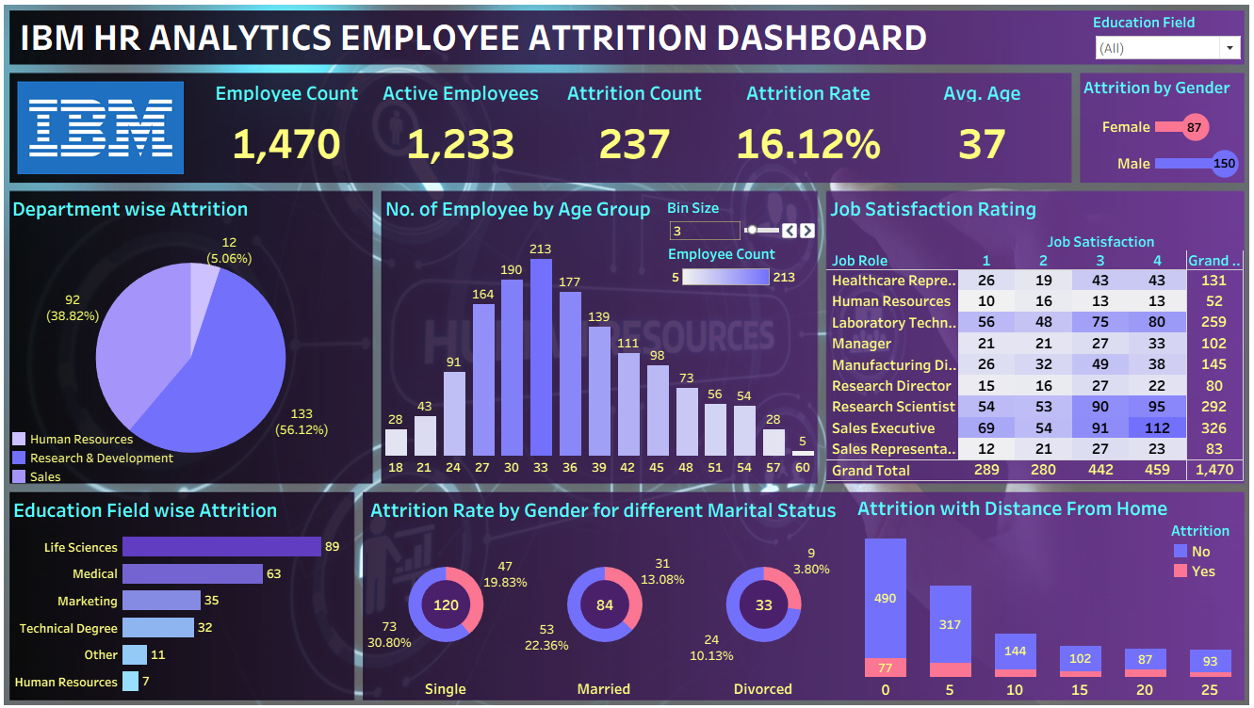
© Subrata Dey | Data Analyst | 2026

Slide 8
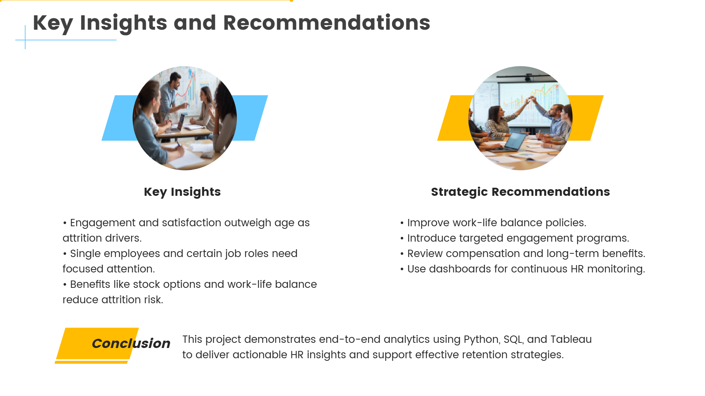
© Subrata Dey | Data Analyst | 2026

